Slide 1
Gripping Force Comparative Analysis

Slide 2
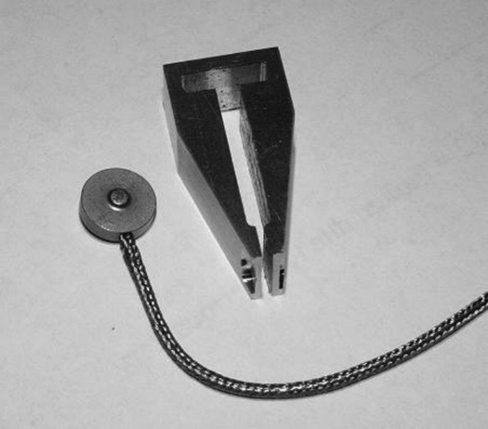
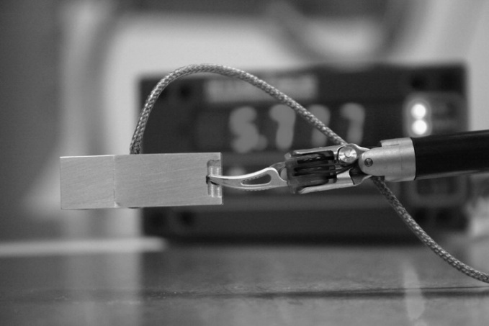
Reference Paper Analysis
▶ Mucksavage, Phillip, et al. "Differences in grip forces among various robotic instruments and da Vinci surgical platforms." Journal of endourology 25.3 (2011): 523-528.
▶ Measurement of gripping force according to da Vinci system and its end-tool.
▶ Methond of Measurement
Install Load Cell and build housing to bite (hold) end-tool.
Using the Bulldog Clamp, compare the measurements of ①directly gripping the Load Cell and ② Gripping the Load Cell after installing it in the housing to derive a conversion formula.
After gripping the mount with the end-tool, measure the load acting on the Load Cell, and derive the actual gripping force through the conversion formula.

Slide 3
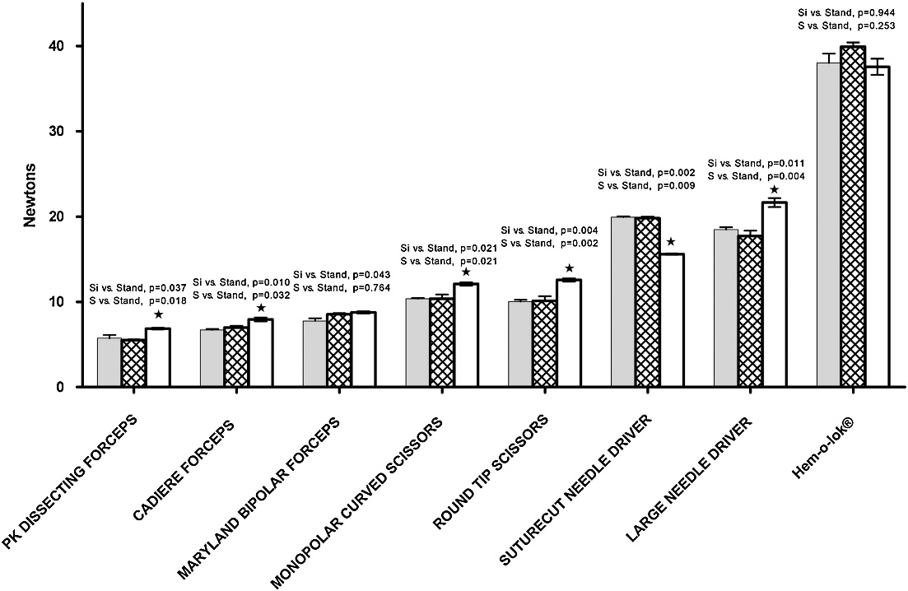
Reference Paper Analysis
▶ Main measurement results
- Gripping Force of da Vinci’s Needle Driver : About 15~22N (newton)
Maximum 22N

Slide 4


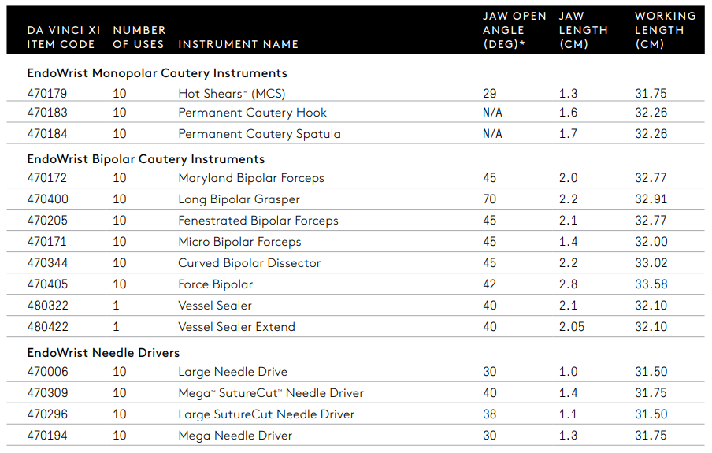
Reference Paper Analysis
▶ Measurement device dimension estimation and force covernsion
Estimation of the main dimensions on the photo from actual measurements of Da Vinci end-tools.
Jaw Contact Point: Jaw mounting position 3mm
➔ Jaw contact point Pivot Length : (Jaw Length) -3mm
Load Cell Pivot Length 10.4mm
Load Cell mounting position
Contact Point Pivot Length26.7mm
3.6mm
(Actual Measurement)
Induced Jaw Length 20.5mm
(Da Vinci data: 20mm, About 2.5% error
Calculation of Gripping Force Torque on Da Vinci Needle Driver
 | Large Needle Driver | Large SutureCut Needle Driver
Measuring Force (Max) [N] | 20 | 22
Contact point Force [N] | 7.8 | 8.6
Jaw Length [mm] | 10 | 11
Jaw contact point pivot Length [mm] | 7 | 8
Jaw Torque [N mm] | 54.6 | 38.8

Slide 5
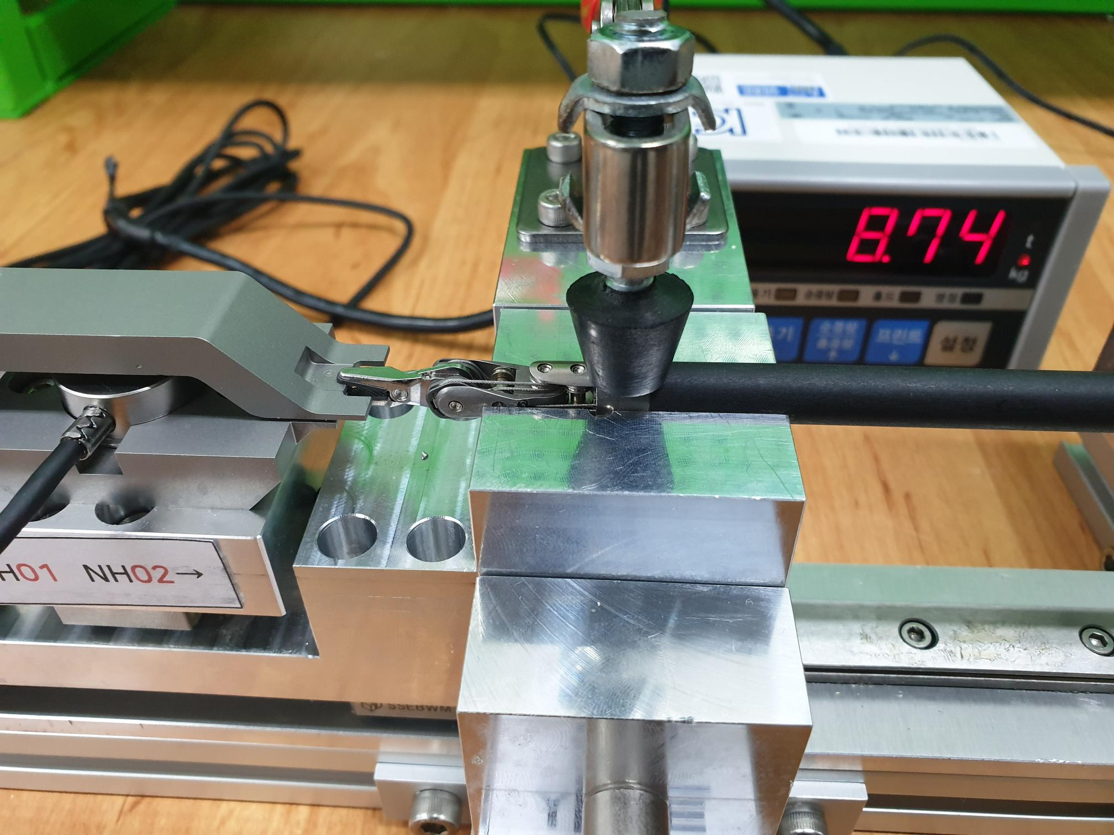
Comparative Analysis with LIVSMED’s Products
▶ Comparison with quality standard
Main dimensions of LIVSMED NH01, NH02, and Gripping Force measuring equipment
Jaw contact point pivot
NH01: 6.5mm
NH02: 6.0mm
Length of load cell pivot 30mm
Length of contact point pivot 60mm

Slide 6
Comparative Analysis with LIVSMED’s Products
▶ Comparison with quality standard
Quality standard Gripping Force of NH01, NH02: Based on Load Cell Measurements 105N ~ 110N
Calculation of Gripping Force Torque and comparison with Da Vinci End-tool
 | NH01 | NH02
Quality Standard Force (Max.) [N] | 110 | 110
Contact point Force [N] | 55 | 55
Jaw contact point pivot Length [mm] | 6.5 | 6.0
Jaw Torque [N mm] | 357.5 | 330
 | Da Vinci |  | LivsMed
 | Large Needle Driver | Large SutureCut Needle Driver | NH01 | NH02
Jaw Torque [N mm] | 54.6 | 38.8 | 357.5 | 330
➔ LivsMed NH01, NH02 shows approximately 7 to 8 times stronger Gripping Force Torque than Da Vinci Need Driver.
However, in the paper that tested with Da Vinci, due to the structure of the sensor housing, a value lower than the actual Gripping Force was measured by the sensor.
Therefore, the difference in Gripping Force Torque is not up to 7 to 8 times.

